Slide 1
Chapter 11
The Component Lifecycle

Slide 2
Objectives
Meet the Lifecycle Methods
See the Lifecycle Methods in Action
The Initial Rendering Phase
Getting the Default Props, State
The Updating Phase
The Unmounting Phase

Slide 3
Meet the Lifecycle Methods
Lifecycle methods aren’t very complicated. You can think of them as glorified event handlers that get called at various points in a component’s life.
componentDidMount
componentWillUnmount
componentDidUpdate
shouldComponentUpdate

Slide 4
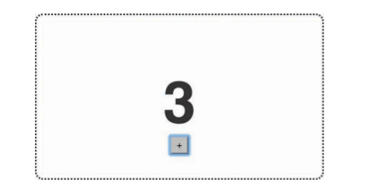
See the Lifecycle Methods in Action
To play with this example, go to the following URL: https://www.kirupa.com/react/lifecycle_example.htm. When this page loads, you’ll see a variation of the counter exampleyou saw earlier

Slide 5
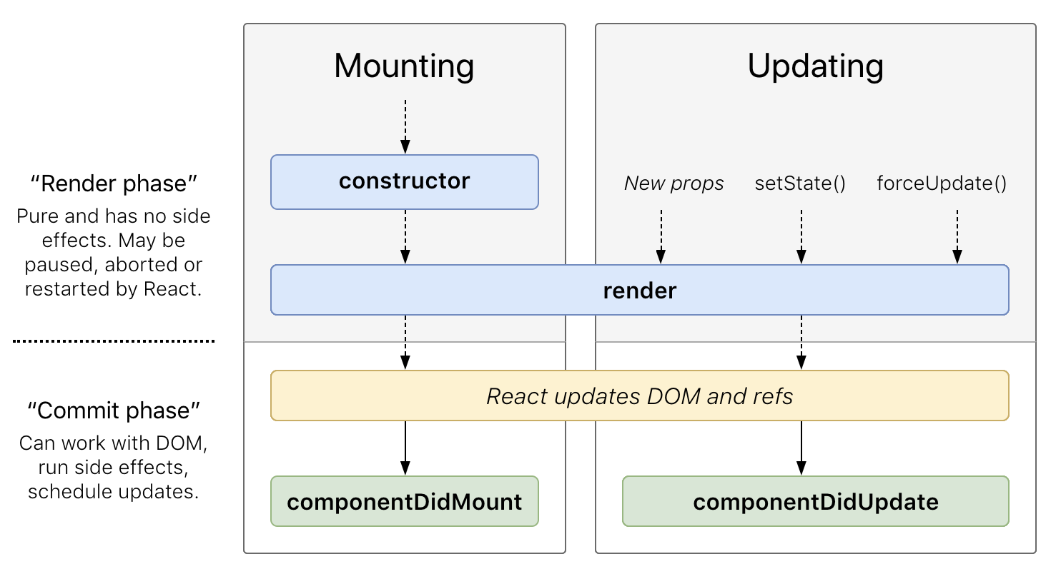
See the Lifecycle Methods in Action

Slide 6
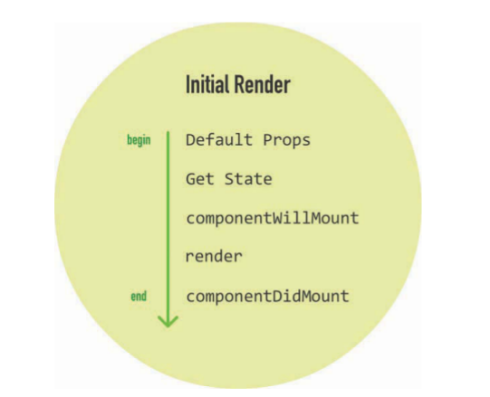
The Initial Rendering Phase
When your component is about to start its life and make its way to the DOM, the following lifecycle methods get called

Slide 7

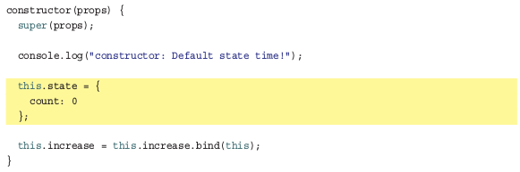
The Initial Rendering Phase
Getting the Default Props
Getting the Default State

Slide 8
The Initial Rendering Phase
componentWillMount
This is the last method that gets called before your component gets rendered to the DOM.There’s an important point to note here: If you call setState inside this method, your component will not re-render.
Render
This one should be very familiar to you by now. Every component must have this method defined, and it is responsible for returning some JSX. If you don’t want to render anything, simply return null or false .

Slide 9
The Initial Rendering Phase
componentDidMount
This method gets called immediately after your component renders and gets placed on the DOM. At this point, you can safely perform any DOM querying operations without worrying about whether your component has made it. If you have any code that depends on your component being ready, you can specify all of that code here as well.
With the exception of the render method, all of these lifecycle methods can fire only once.That’s quite different from the methods you see next.

Slide 10
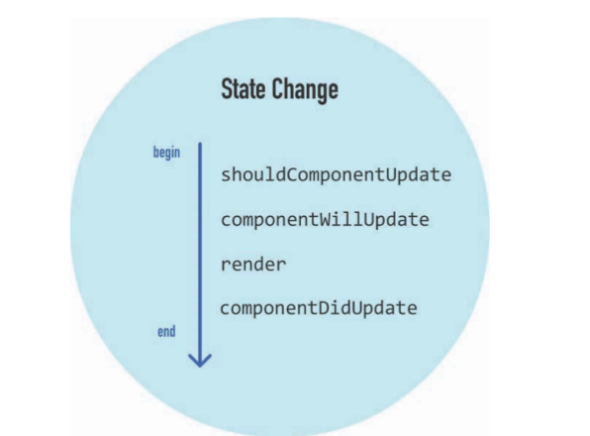
Dealing with State Changes
When a state change happens, all the lifecycle methods

Slide 11
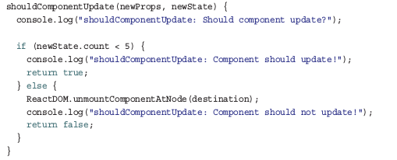
Dealing with State Changes
shouldComponentUpdate
This method allows you to control this updating behavior. If you use this method and return a true value, the component will update. If this method returns a false value, this component will skip updating.

Slide 12
Dealing with State Changes
componentWillUpdate
This method gets called just before your component is about to update. Nothing too exciting happens here. One point to note is that you can’t change your state by calling this.setState from this method.
render
If you didn’t override the update via shouldComponentUpdate , the code inside render get called again to ensure that your component displays itself properly.
componentDidUpdate
This method gets called after your component updates and the render method has been called. If you need to execute any code after the update takes place, this is the place to stash it.

Slide 13
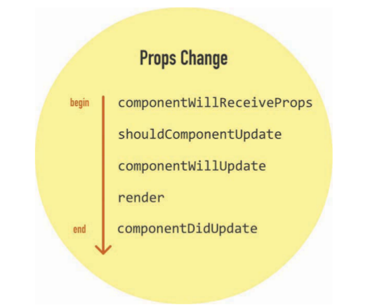
Dealing with Prop Changes
The other time your component updates is when its prop value changes after it has been rendered into the DOM.
We have the same processes with state, instead of work with state, this

Slide 14
Dealing with Props Changes
componentWillReceiveProps
This method allows you to control this updating behavior. We can check props which component will receive and adjust them before pass to component
shouldComponentUpdate
This method gets called just before your component is about to update. You can choose to update or not by return true or false, if true => component update, false => component will not
render

Slide 15
Dealing with Props Changes
componentDidUpdate
This method gets called after your component updates and the render method has been called.You can check previous and current props in here.

Slide 16
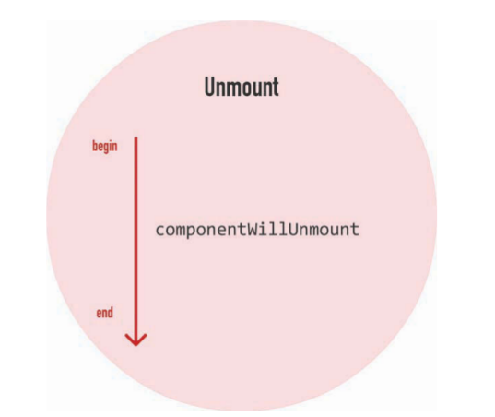
The Unmounting Phase
The last phase to look at is when your component is about to be destroyed and removed from the DOM

Slide 17
Conclusion
Components are fascinating little things. On the surface, they seem like they don’t have much going on.
React is constantly watching and notifying your component every time something interesting happens.
I want to reassure you that knowing what each lifecycle method does and when it gets called will come in handy one day. All that you’ve learned isn’t just trivial knowledge, although your friends will be impressed if you can describe every lifecycle method from memory.

